Slide 1
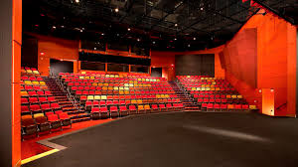
Set Design for the Theatre

Slide 2
Realistic Sets

Slide 3
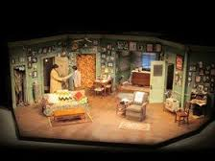
Realistic Sets

Slide 4
Semi-Realistic Interior Set

Slide 5
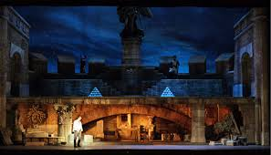
Realistic Sets

Slide 6
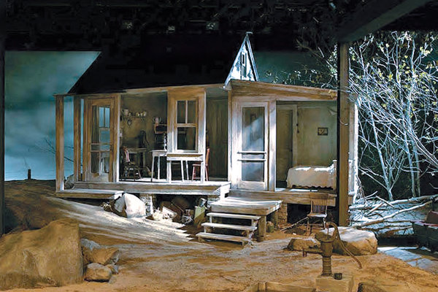
Naturalistic Sets

Slide 7
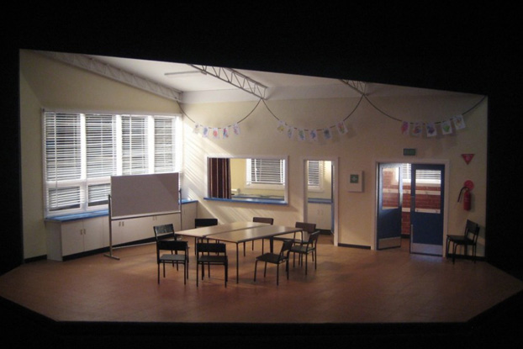
Naturalistic Sets

Slide 8
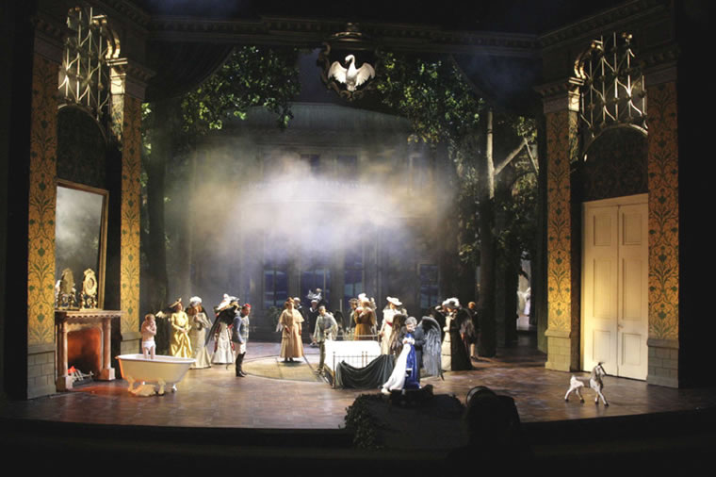
Naturalistic Sets

Slide 9
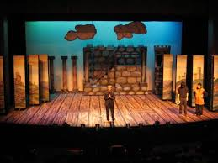
Impressionistic Sets

Slide 10
Impressionistic Perspective Set

Slide 11
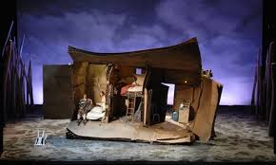
Impressionistic Sets

Slide 12
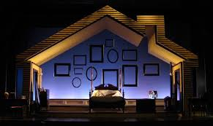
Impressionistic Set

Slide 13
Crossover Impressionist/ Realistic

Slide 14
The Glass Menagerie
Tennessee Williams makes a big deal out of telling us all about the apartment. He wants us to know how the buildings are all stacked up like a beehive, so we get the sense of dehumanization and confinement to working roles. Because the action ONLY takes place at the apartment, we can sense Tom’s feelings of being trapped, the fact that he is contained in only one location along with his family. The fire escape, of course, is crucial, being a means of escape and all. It kind of hangs out there like a constant foreshadowing of Tom’s eventual escape. It’s also, fittingly, the place where narrator Tom does a good deal of his narrating. This makes sense – narrator Tom has already escaped, so he speaks to us from outside the apartment.

Slide 15
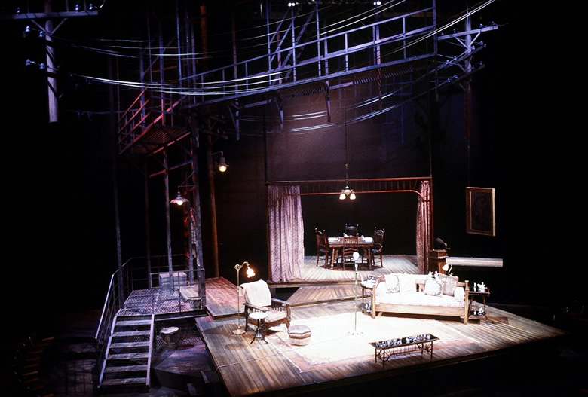

Slide 16
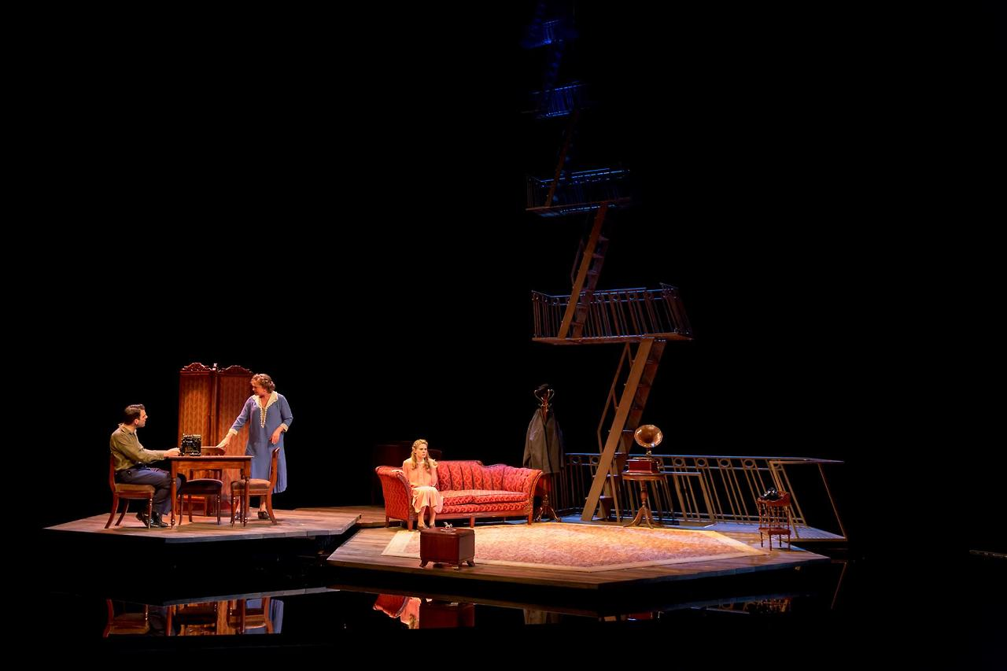

Slide 17
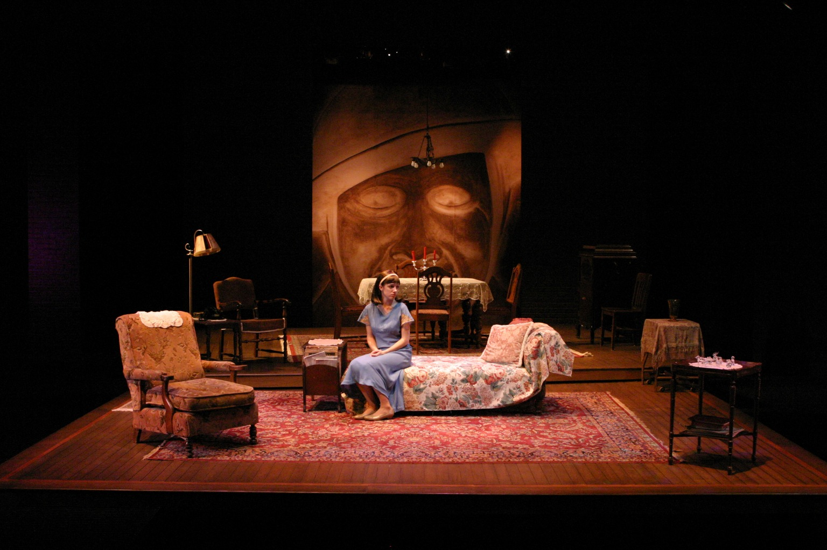

Slide 18
A Midsummer Night’s Dream

Slide 19
A Midsummer Night’s Dream

